Slide 1



J.S.S. ACADEMY OF TECHNICAL EDUCATION , NOIDA
MINI-PROJECT
" GAME - ZONE "
By - VIKRAM YADAV
Roll no. - 1900910100196

Slide 2


TECHNOLOGIES USED....

Slide 3
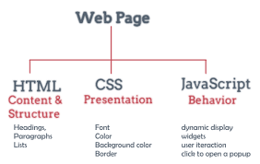
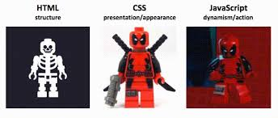
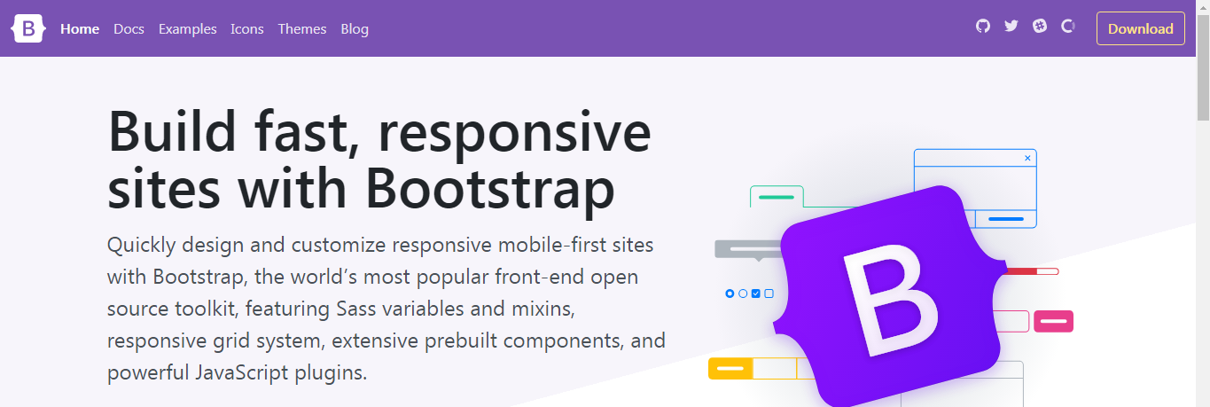
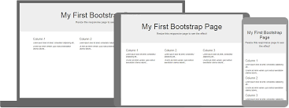
"FRONT - END TECHNOLOGIES"

Slide 4



"BACK - END TECHNOLOGIES"
PHP is an acronym for "PHP: Hypertext Preprocessor“.
PHP is a widely-used, open source scripting language.
PHP scripts are executed on the server.
MySQL is a database system that runs on a server.
MySQL uses standard SQL.
The data in a MySQL database are stored in tables.

Slide 5

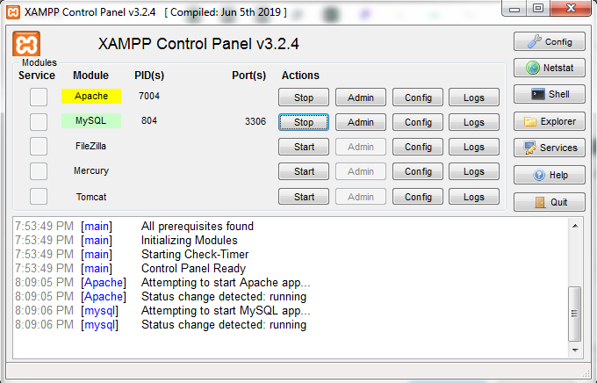
What is XAMPP?
XAMPP is the most popular PHP development environment. XAMPP is a completely free, easy to install Apache distribution containing MariaDB, PHP, and Perl. The XAMPP open source package has been set up to be incredibly easy to install and to use.

Slide 6



WORK FLOW
SERVER
PHP FILE
DBMS
CLIENT

Slide 7
PROJECT DESCRIPTION
GAME-ZONE is a “Responsive” gaming website . It allows user to play and enjoy a game either by not creating an account(directly) or by creating their own account. If a user creates an account through a valid email-ID and play that game by singn-in through same email, he/she can see their wins and looses , everytime when they play that game.
The website upholds a single game, named “BAT & BALL” . The RULES for the game are very simple :
The batting team will be given three wickets to score runs .
If the number predicted by both teams are same , the batting team will lost a wicket , otherwise it will get runs equal to it’s prediction.
The predicted no. should be between 1 and 6.
LET US HAVE LOOK….
GAME ZONE

Slide 8




Slide 9
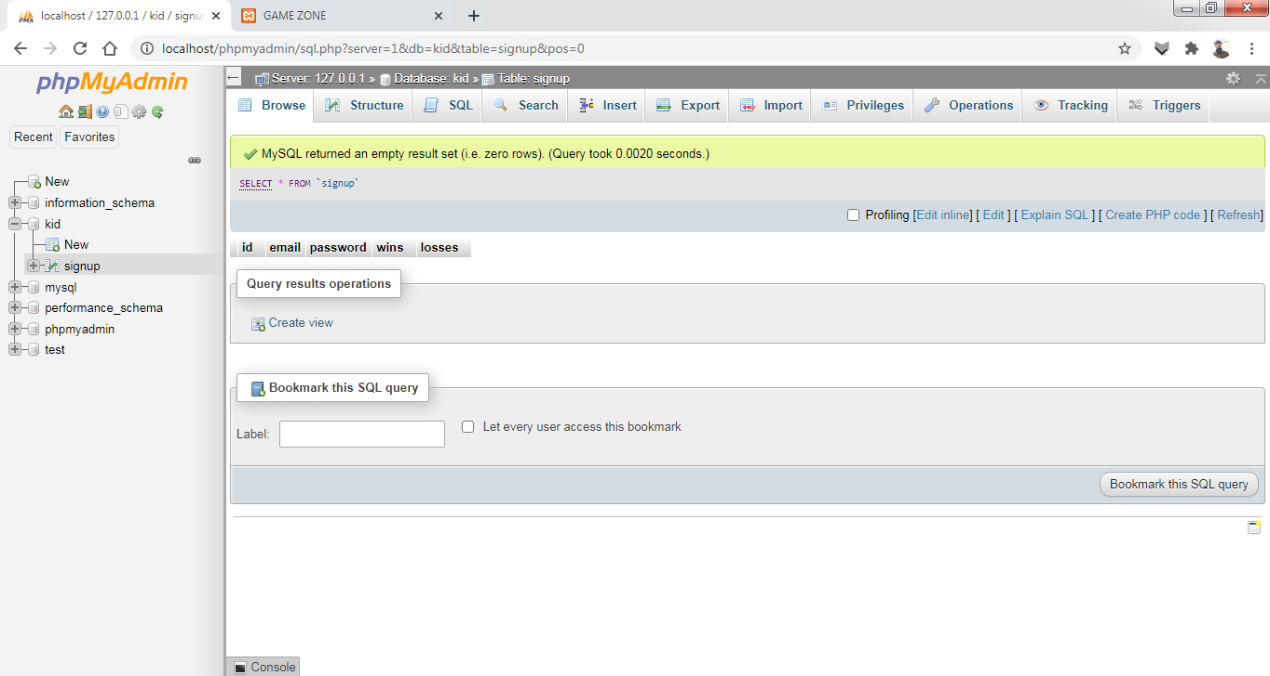

Slide 10
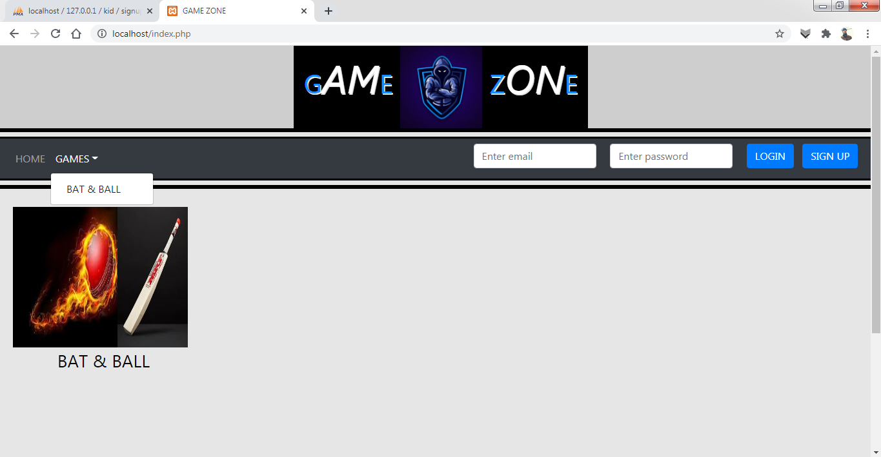

Slide 11
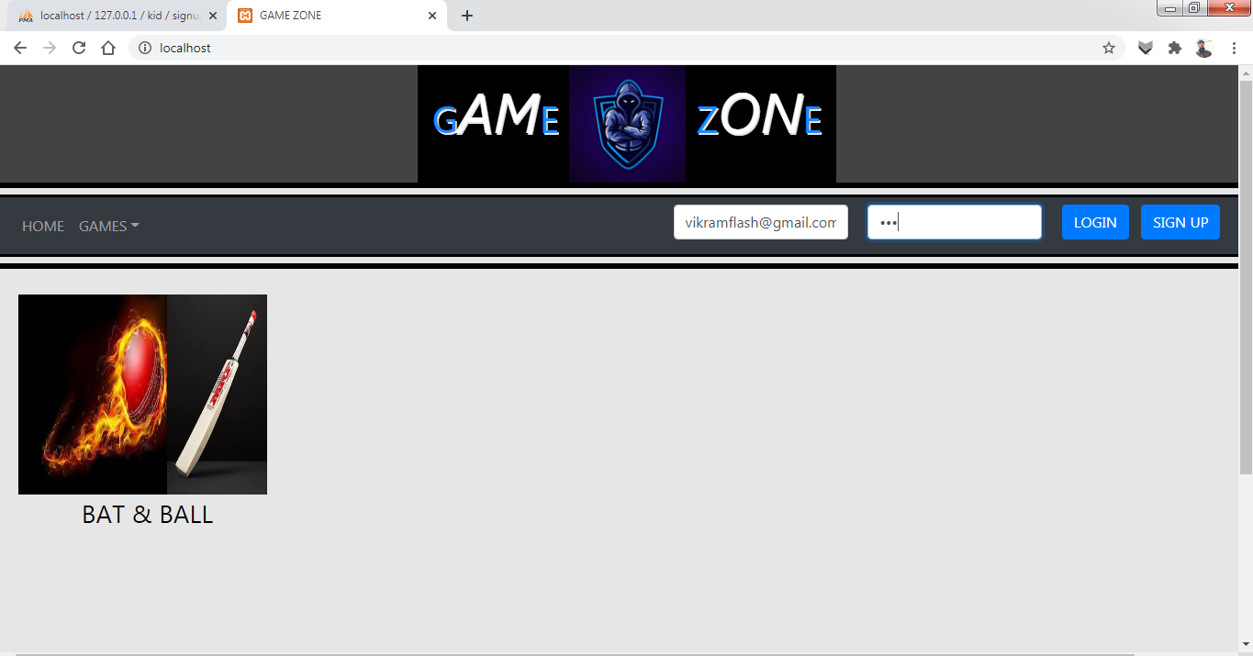

Slide 12
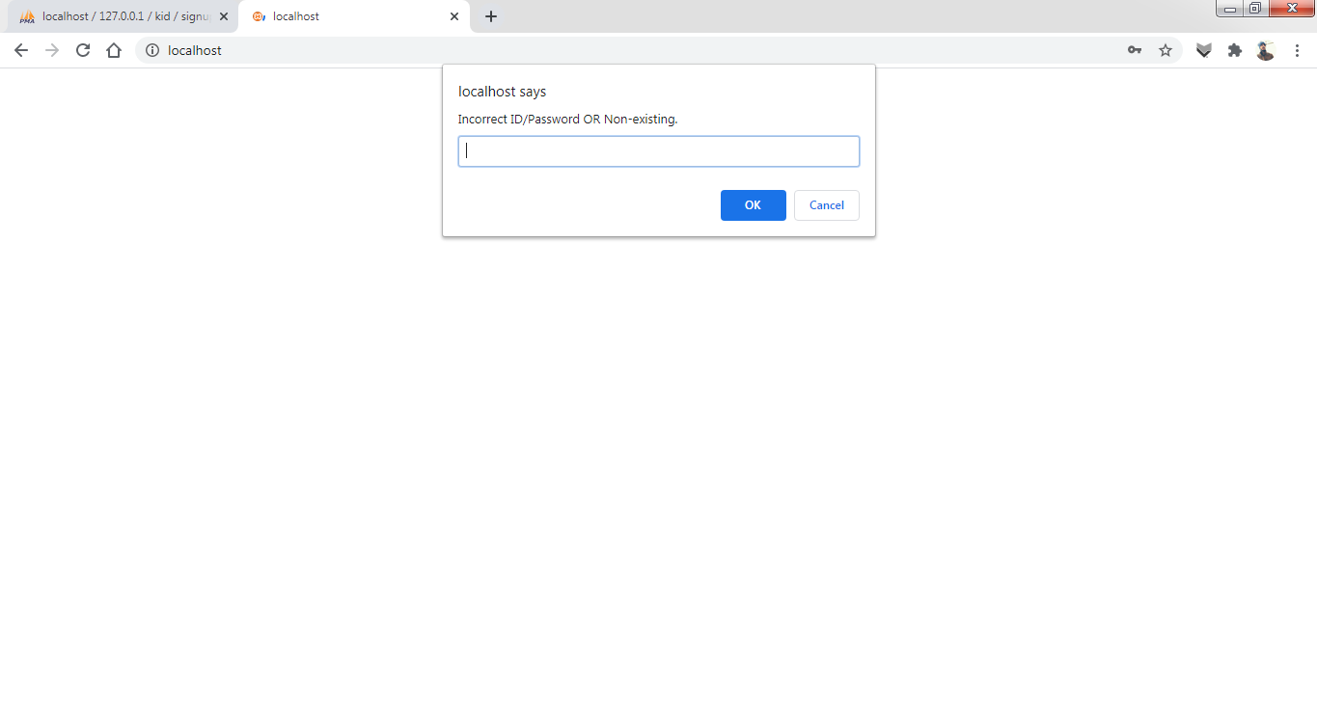

Slide 14
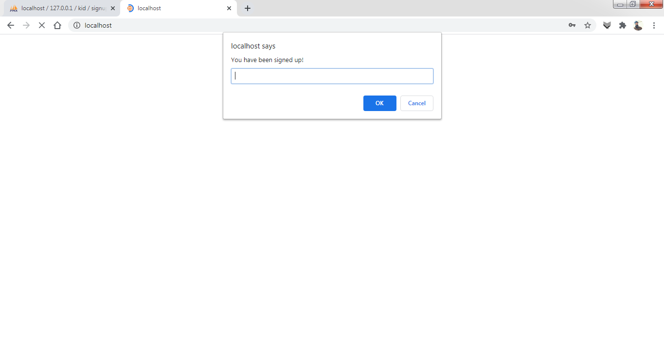

Slide 15
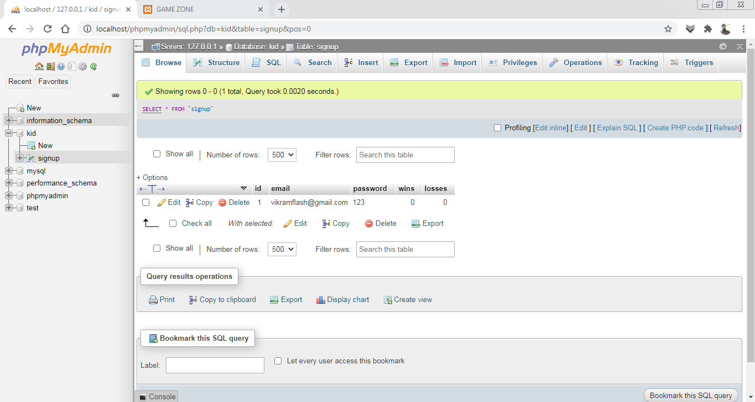

Slide 16
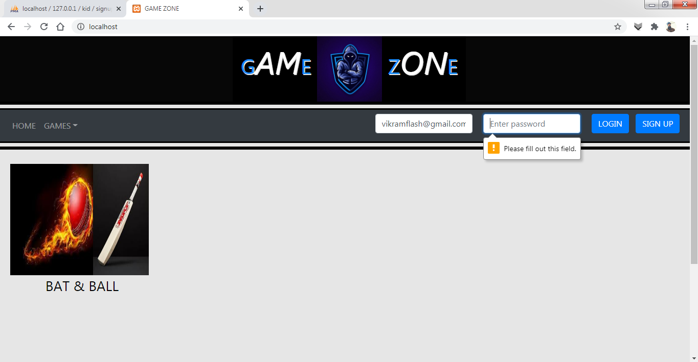

Slide 17
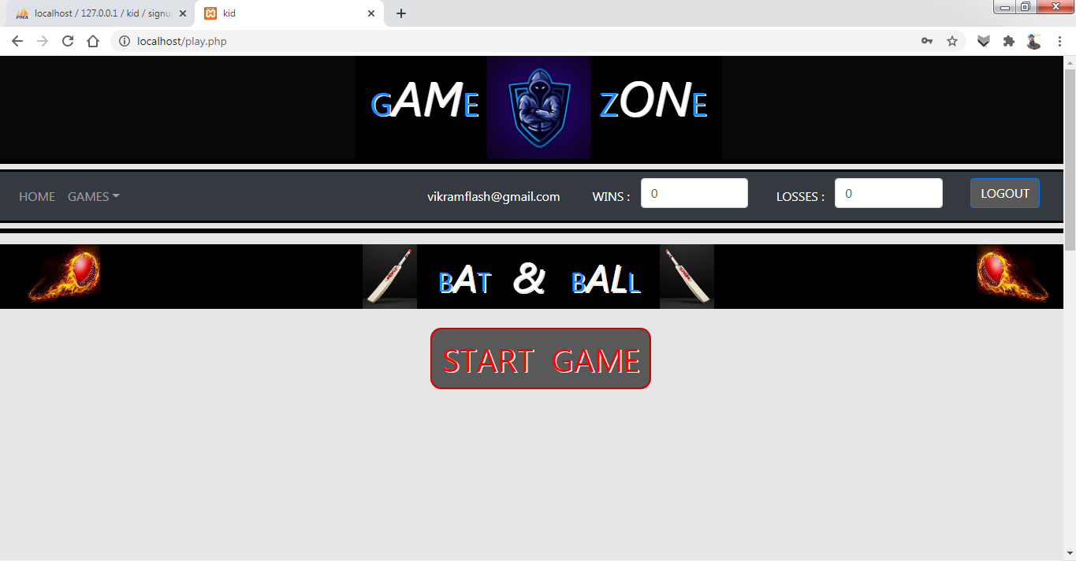

Slide 18
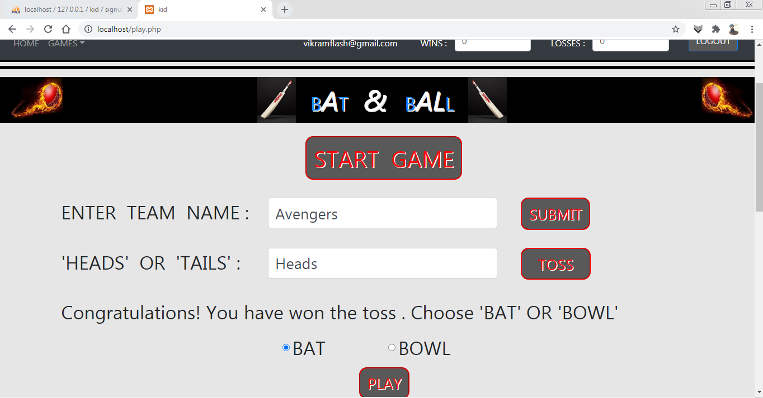

Slide 19
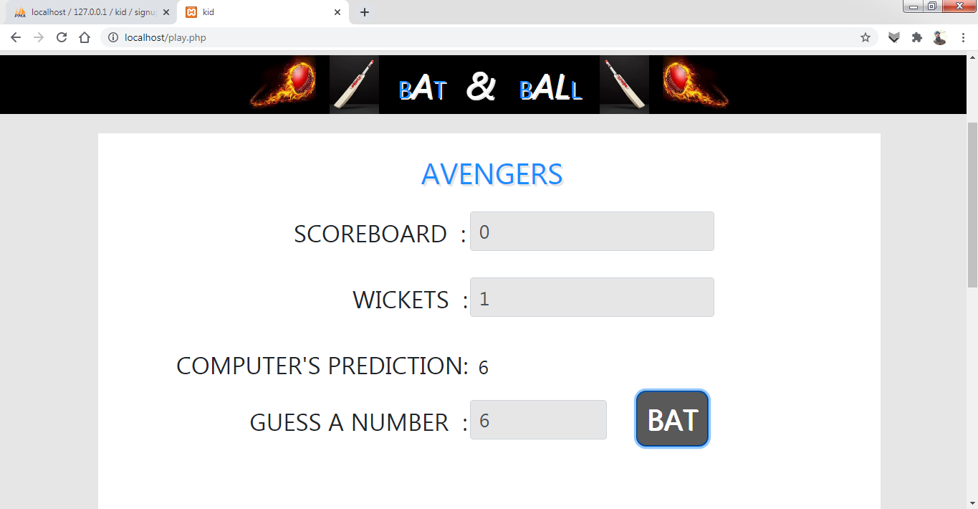

Slide 20
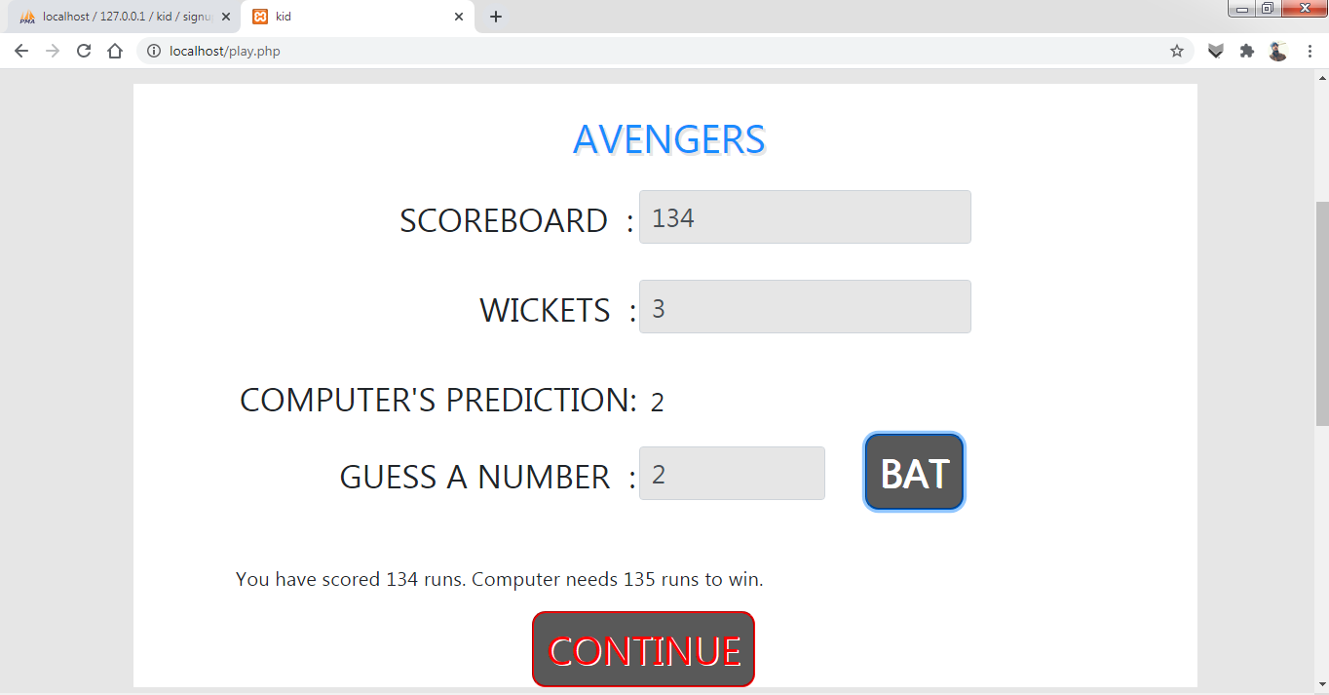

Slide 21
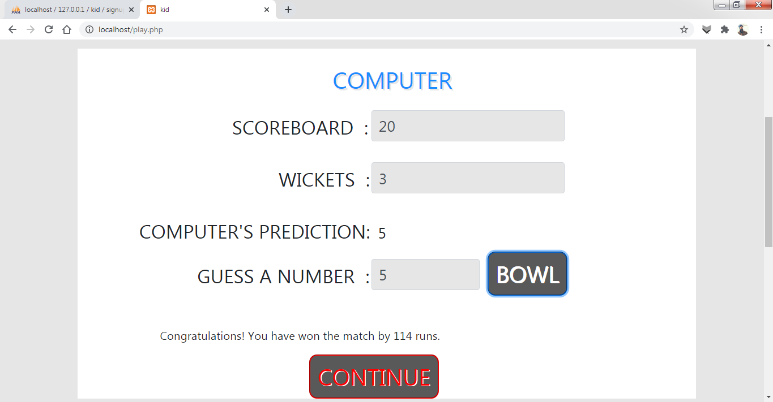

Slide 22
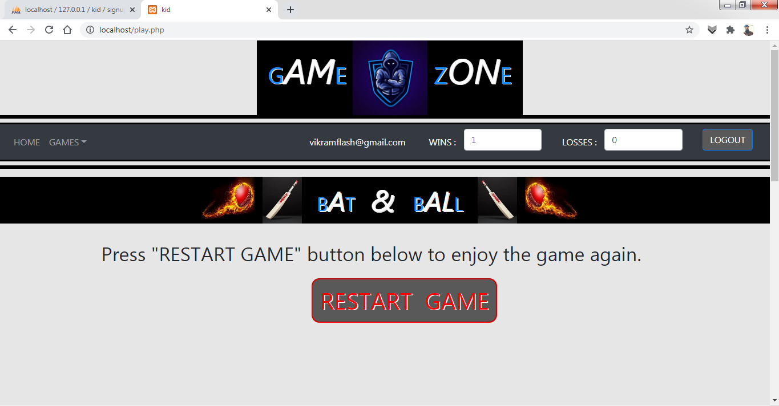

Slide 23
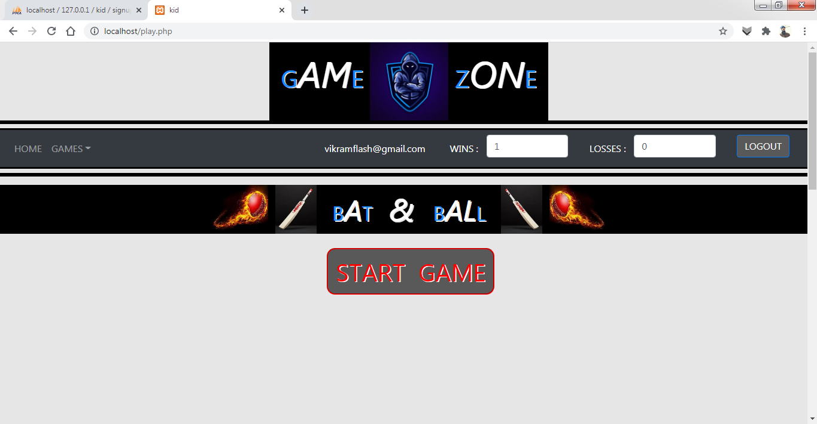

Slide 24
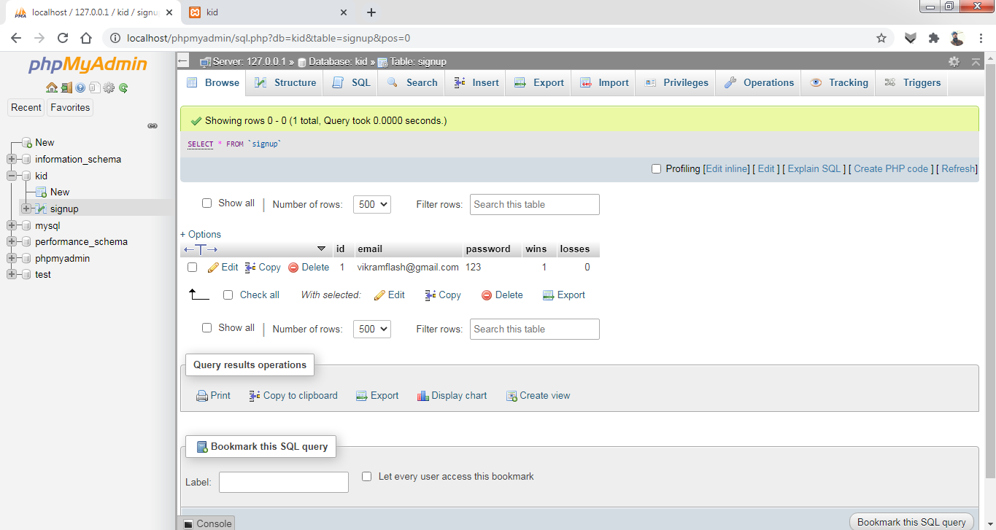

Slide 25
LET'S HAVE A LOOK ON
DEMO OF THE PROJECT

Slide 26
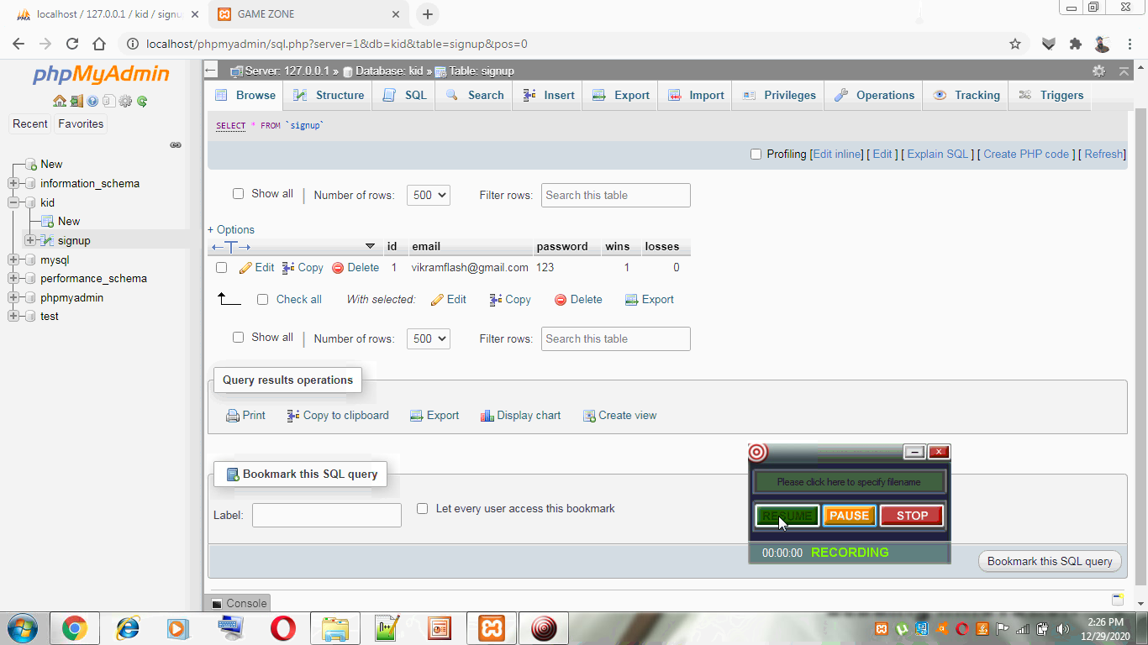


Slide 27

.....THANK YOU.....

